Slide 1

AI by Lavika Goel
Chapter 2
8th Jan 2023

Slide 2
2.1 Introduction
AI is the doorway of converting a simple computer into an intelligent computer.
AI is based on how to make machines think like humans.
This means AI is the study of how the brain works, thinks and decodes problems to arrive at solutions.
For solving a problem, first a problem has to be presented, then its output needs to be found repeatedly until an optimal solution can be returned
There are number of variables and terms that affect the transition from start of the problem to reach the goal state or desired state.

Slide 3
2.2 State Space Search
State space search is the method that works by considering successive states or configurations.
The collection of states in a set can be represented as a graph.
The route with which the goal state can be reached is call a path.
Because the graph generated by state space is very large, nodes are generated and instantly discarded when the task is completed.
A
B
There is an edge only if there is an operation that leads state A to state B
F
I
Solution to space search can be a path from start to goal state or it can also be only a final state
S
F

Slide 4
2.2 State Space Search
Uninformed Search
Informed Search
Unguided search
Group of algorithms work by brute force.
General algorithms have no extra information apart from the information provided in the problem statement.
One can only differentiate between final and non-final states.
Domain of the problem is typically unknown.
DFS, BFS, UCS, IDDFS are some of the examples.
Heuristic search
Best first search is the approach used.
Evaluation function f(n) is used to expand a node on the basis of lowest cost first.
Extra information is given to the algorithm through heuristic function h(n).
Some of the examples are greedy best first search, A* search, memory-bounded heuristic search.

Slide 5
2.2 State Space Search
A state can be defined in two ways – Undefined and finite
Search problem can be defined using four tuples and is represented as (S, s, O, G), where S represents the set of states, s represents the initial state, O represents the set of operators and G represents the goal states.
State space search is formally represented as <S, A, Action(s), Result(s, a), Cost(s, a)>
Important terminologies-
Start state
Goal state
State space
Action space
Transition model
Goal test
Path cost

Slide 6
2.2.1 Hill Climbing Problem (applicable only for convex problems)
2.2.1.1 Simple Hill Climbing
2.2.1.2 Steepest-Ascent Hill Climbing
Investigates neighbouring nodes in a sequential way.
Permutations of the initial states are used to generate the next states and then choose the better state.
Examines the neighbouring nodes and then chooses the closest that is to the solution as a successor node.

Slide 7
2.2.1 Hill Climbing Problem
9
a
4
6
7
b
c
d
6
2
3
1
5
e
f
g
h
i
2
1
1
t
4
Red path – steepest ascent
Green path – simple hill

Slide 8
2.3 Production System
It is a computer program that provides artificial intelligence via a set of rules. It also provides the mechanism to follow the rules.
These rules are known as productions and are made of two parts:
Precondition
Action statement
It has a database which is referred to as a working memory.
The production system has three important components – Set of production rules, knowledge database and control strategy.
The implementation of the production system follows four steps:
Defining the problem
Analyse the problem
Remove irrelevant information
Choose the best solving technique.

Slide 9
2.3 Production System
Production system can be broadly classified into two categories:
Monotonic production system – In this system, if a rule is applied then that will not prevent from other rules being applied.
Partially commutative production system – If a particular sequence of steps is applied to reach state Y from state X, then any one of the permutations of these rules should also generate state Y.
Usually both these production systems are implemented without backtracking to previous states which increases the efficiency as changes made during the search process are not stored.
Monotonic production system doesn’t know any contradictory information to what it already knows and hence, the knowledge base grows in a monotonic fashion with new facts.
Non-monotonic production systems might learn new facts that might be contradicting to the information it already possess, so it replaces old info with new one and hence makes it more applicable to real problems.

Slide 10
2.4 Problem Characteristics
These questions need to be answered to select the best heuristic technique for a specific search:
Is the problem that we are solving decomposable?
Can we ignore the solution steps or can it be undone?
Ignorable, recoverable, irrecoverable
Can we predict the universe?
Certain outcome, Uncertain outcome
Is a solution relative or absolute?
Any path problem, best path problem
Do we want a state as a solution or path as a solution?
What role does knowledge play?
Is interaction with the person required by the task?

Slide 11
2.5 Control Strategy
This forms the basis on which we should pick the first rule and evaluate. These are the requirements for a good control strategy:
It should cause motion and should not be stuck in an infinite loop.
It should be systematic. Systematic control strategy means it should have a global motion as well as some local motion. Examples include BFS, DFS.
It should be efficient because some problems have very high time complexities.

Slide 12
2.6 Issues in Design of Search Programs
Backward vs Forward reasoning.
Matching the rules accurately to the states.
Frame problem or knowledge representation problem.
A lot of overlapping sub-problems.
Bookkeeping can be used to solve overlapping sub-problems to increase efficiency but it comes at an extra cost.
BFS can be used to keep track of generated nodes. DFS can also be used by using some extra storage to retain the expanded and backed up nodes in memory.
If it is known that a particular node can be generated in many different ways, then a graph is preferred over a tree. But there is a possibility of forming cycles with graphical method.

Slide 13
2.7 Search Strategies
A problem determines the initial state and a goal state but to identify the path from start state to goal state is the job of a search strategy.
2.7.1 Uninformed Search Category
This type of search is also known as unguided or blind search. The group of algorithms in this category typically work by brute force, which means each and every node is traversed to get a solution.

Slide 14
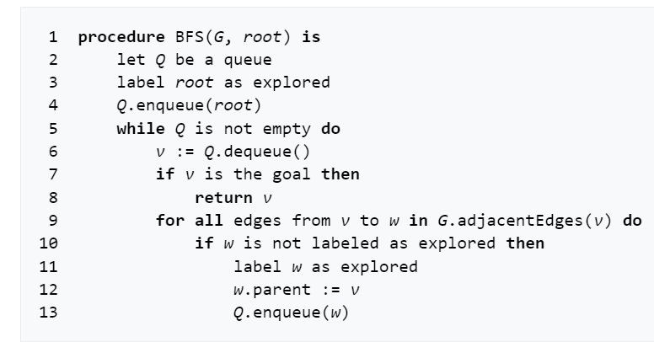
2.7.1.1 Breadth First Search
Queue
a
b | c
c | d | e
d | e | f | g
e | f | g
f | g | h
g | h
h
Source: Wikipedia
Path: abcdefeh

Slide 15
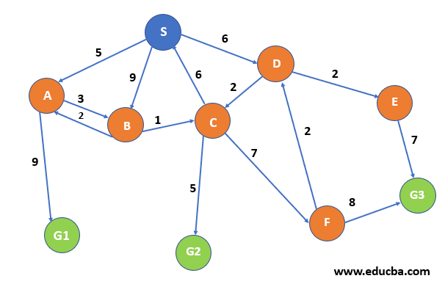
2.7.1.2 Uniform-Cost Search
Uniform cost search is an uninformed method to find the least cost path from start state to goal state
Algorithm:
Root Node
Path-Cost = 0
Queue Priority Queue
Visited a vector
Loop
v dequeue
v = goal then return node
insert node in visited
For all children w of v
if w is not visited and not in queue
enqueue(w)
else if w in queue with higher path cost
replace w

Slide 16
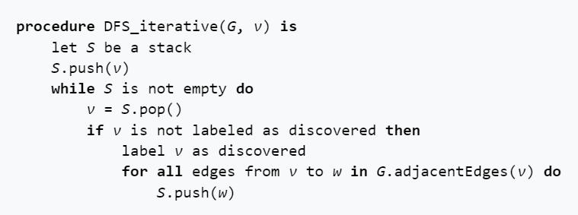
2.7.1.3 Depth-First Search
1
9 | 5 | 2
9 | 5
9 | 5 | 3
9 | 5
9 | 5 | 4
9 | 5
9
9 | 8 | 6
9 | 8
9 | 8 | 7
9 | 8
9
10
1 – 9,5,2
2 - 3
3 - 4
4 - null
5 – 8,6
6 - 7
7 - null
8 - null
9 - 10
10 - null
Source: Wikipedia
Adjacency list
Stack

Slide 17
2.7.2 Informed Search Strategies
These strategies have specific knowledge about the problem
This is more efficient in finding solution than uninformed strategy.
The usual approach is best first search.
The expansion is done on the basis of an evaluation function f(n).
The search strategy depends on the choice of the function, f.
Through heuristic function h(n), extra knowledge is given to the algorithm.

Slide 18
2.7.2.1 Greedy Best First Search
Node | H(n)
A | 11
B | 5
C | 9
D | 8
E | 4
F | 2
H | 7
I | 3
S
This is implemented using H(n) heuristic function.
A
B
Open List | Close List
[S] | []
[A,B] | [S]
[A,E,F] | [S,B]
[A,E,I,G2] | [S,B,F]
Path : S,B,F,G2
C
D
E
F
H
G1
I
G2

Slide 19
2.7.2.2 A* Search
It is one of the most used and known best first search algorithms.
The evaluation function is the hybrid of two heuristic functions.
F(n) = g(n) + h(n) where g(n) is the cost to get to the current state from start state and h(n) is the cost to get to the goal state from current state.
There are few conditions that need to be satisfied to obtain optimality:
Admissibility: The function h(n) should never overestimate the cost of reaching the goal state.
Consistency: This condition needs to be satisfied for graph searches. H(n) should always be less than or equal to h(n)+g(n)

Slide 20
2.8 Advanced Problems
The tower of Hanoi Problem
The Missionaries and Cannibals Problem
The Monkey and Bananas Problem
Cryptarithmetic Problem
Alphametic
Digimetic
Skeletal Division

